Slide 1

IBM University Engagement Project Submission
“Exploring the Power of Agentic AI with IBM Granite and LangFlow”

Slide 2

Project Title – NutriSync AI: Personalized Nutrition Agent
Domain of Project – Healthcare
Student Name | Recent Passport Photo | Email ID | Mobile number [WhatsApp]
harshvardhan4043@gmail.com
9651882861
HARSH VARDHAN
SINGH

Slide 3
Problem Statement - NutriSync AI: Personalized Nutrition Agent
The Challenge
Good nutrition is the cornerstone of lifelong wellness, yet individuals struggle with personalized diet planning, calorie estimation, and tracking macronutrients. Dietary information is scattered across unverified sources, lacking cultural awareness and medical grounding. Without real-time, culturally tailored guidance, users fail to sustain balanced habits or manage chronic lifestyle conditions.
The Objective
Build an autonomous AI-powered Nutrition Agent that delivers personalized, clinically grounded, and culturally authentic dietary guidance. The system achieves:
* Personalized Diet Plans: Customized to age, biological sex, BMI, activity multipliers, and fitness goals.
* Grounded RAG Knowledge Retrieval: Queries verified ICMR-NIN Indian food compositions to eliminate AI hallucinations.
* Clinical Condition Management: Conservative clinical guidelines for Diabetes, PCOS, Hypertension, and Weight Management.
* Strict Calorie Safety Floors: Enforces WHO minimum safety thresholds (1200 kcal female / 1500 kcal male) and pediatric advisory.
* Multi-Agent Architecture: Autonomous coordination across Assessment, RAG Retrieval, Recommendation, and Output agents.

Slide 4
Proposed Solution - NutriSync AI - Autonomous Nutrition Agent
NutriSync AI is an intelligent, zero-backend, multi-agent nutrition system built with IBM watsonx Orchestrate and IBM Granite Foundation Models to deliver real-time, personalized, and culturally grounded dietary guidance.
Core Pillars of the Proposed Solution:
1. Grounded Knowledge Retrieval (RAG): Ingests ICMR-NIN Indian Food Composition Tables and clinical guidelines (Diabetes, PCOS, Hypertension) via IBM Docling RAG to ensure zero factual drift.
2. Clinical Health Assessment Engine: Executes Mifflin-St Jeor formula for BMR, applies physical activity multipliers for TDEE, and enforces hard safety floors (1200 kcal female / 1500 kcal male).
3. Pediatric Safety Protocol: Automatically detects age under 18, suppresses caloric deficit recommendations, and displays growth-friendly nutritional guidance.
4. Multi-Agent ReAct Orchestration: Autonomous coordination across specialized agents: Assessment Agent, Knowledge Agent, Meal Planning Agent, and Safety Guardrail Agent.
5. 100% Client-Side Privacy: Zero backend server and zero database storage. All health computations run inside the user's browser, guaranteeing total data confidentiality.

Slide 5
Technology Used
  IBM watsonx Orchestrate: Autonomous ReAct agent platform for conversational nutrition guidance and tool execution.
  IBM Granite 3.2 8B Instruct: Enterprise foundation LLM powering clinical reasoning, summarization, and personalized meal planning.
  IBM Docling & Grounded RAG Pipeline: Document ingestion engine extracting tabular nutrition data from ICMR-NIN food tables.
  IBM Cloud: Provides secure, scalable cloud infrastructure, watsonx instance management, and AI governance.
  Client-Side Web Architecture: Modern single-page application built with HTML5, CSS3, and ES6 JavaScript with 100% data confidentiality.
  Local Static Server: Custom .NET HttpListener (PowerShell) providing local CORS-compliant web serving without external dependencies.

Slide 6
Langflow component Used -
1) Multi-Modal Health Profile Input: Captures age, biological sex, height (cm/ft-in), weight, activity multiplier, diet preference (Veg/Non-Veg/Jain), and health conditions.
2) IBM watsonx AI Agent Orchestrator: Manages conversational ReAct loop, coordinating tool calls, multi-turn state persistence, and real-time guidance.
3) IBM Granite 3.2 8B Instruct Model: Enterprise foundation model synthesizing contextual meal plans, macronutrient breakdowns, and regional ingredient swaps.
4) Grounded Knowledge Retrieval (RAG): Ingests and indexes regional Indian food compositions (ICMR-NIN) and conservative clinical disease guidelines.
5) Clinical Assessment & Safety Floor Engine: Executes Mifflin-St Jeor BMR/TDEE calculations, enforces calorie safety floors (1200/1500 kcal), and triggers pediatric advisories.
6) Interactive Chat Output & Dashboard: Renders structured daily meal schedules, macro percentages, copy-to-agent buttons, and mandatory medical disclaimers.

Slide 7
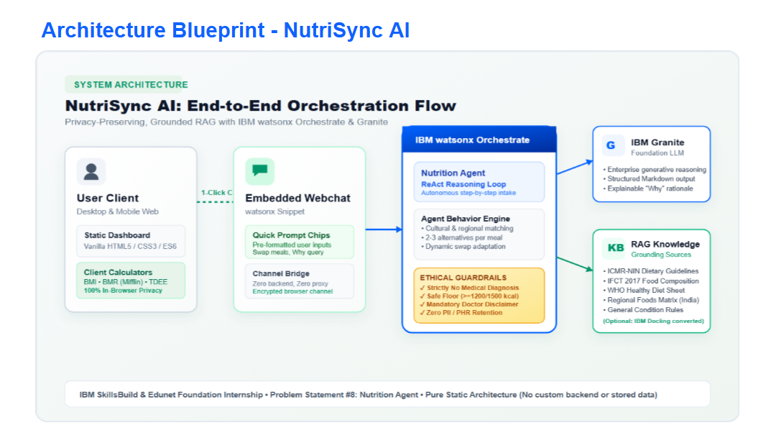
Architecture blueprint

Slide 8

Role of Agentic AI in the solution
Agentic AI transforms NutriSync from a conventional chatbot into an autonomous, proactive digital nutritionist powered by IBM watsonx Orchestrate and Granite Foundation Models:
* Autonomous Decision-Making: Dynamically balances caloric targets against dietary restrictions, regional preferences, and clinical contraindications.
* Multi-Step ReAct (Reasoning + Acting) Loop: Follows an iterative loop: Ingests user metrics -> Computes BMR/TDEE -> Queries ICMR-NIN RAG -> Synthesizes meals -> Audits clinical safety floors.
* Context Awareness & Multi-Turn Memory: Retains user profile attributes across conversational turns, enabling natural refinements and ingredient substitutions.
* Clinical Safety Governance: Proactively flags contraindicated food items (e.g. high glycemic foods for diabetes, excessive sodium for hypertension) and enforces medical disclaimers.

Slide 9
Novelty and Uniqueness
* Pan-Indian Cultural Grounding: Unlike generic Western diet tools, NutriSync is natively grounded in ICMR-NIN datasets covering North, South, East, West, and Central Indian regional cuisines.
* Hard Clinical Calorie Safety Floors: Enforces medical safety minimums (1200 kcal for females, 1500 kcal for males), preventing dangerous crash dieting often produced by unconstrained LLMs.
* Pediatric Safety Guardrail: Proactively protects adolescents under 18 by suppressing deficit targets and guiding healthy nutrient-dense development.
* 100% Client-Side Privacy: Zero backend server and zero database storage. All health computations run inside the browser, guaranteeing complete personal data protection.
* Enterprise Foundation: Built on IBM watsonx Orchestrate and Granite Foundation Models ensuring enterprise reliability, guardrails, and auditability.

Slide 10
Git Hub Link
https://github.com/HarshXO6956/NUTRITION-AGENT
Repository Artifacts & Structure:
1) app.json: Complete bundled application archive with metadata, source files, and configs.
2) PRD_Nutrition_Agent.md: Comprehensive Product Requirements Document and specifications.
3) NutriSync Web App: index.html, css/styles.css, js/calculators.js, js/ui.js, server.ps1.
4) Grounded Knowledge Base: docs/condition_guidelines.pdf, docs/regional_foods.pdf.
5) System Assets: End-to-end architecture diagram (SVG/PNG), custom branding, and presentation.

Slide 11
Future Scope
1. Wearables & Continuous Glucose Monitor (CGM) Integration:
Integrate with fitness wearables (Apple Health, Fitbit) and CGMs to collect real-time heart rate, active calories, and postprandial glucose levels for dynamic, adaptive caloric adjustments.
2. Pan-India Multilingual Voice Assistant:
Expand conversational AI support to regional Indian languages (Hindi, Tamil, Telugu, Bengali, Marathi) with natural voice interactions, democratizing nutrition guidance across rural and urban demographics.
3. Computer Vision Food Recognition (IBM Granite Vision):
Deploy image recognition models to instantly detect complex Indian meals and thalis from smartphone photos, automatically estimating portion sizes and macronutrients without manual typing.
4. Clinical EHR Integration & Dietitian Collaboration Portal:
Provide structured FHIR-compliant dietary logs and metabolic tracking export for seamless collaboration with certified dietitians and integration into hospital Electronic Health Records.

Slide 12
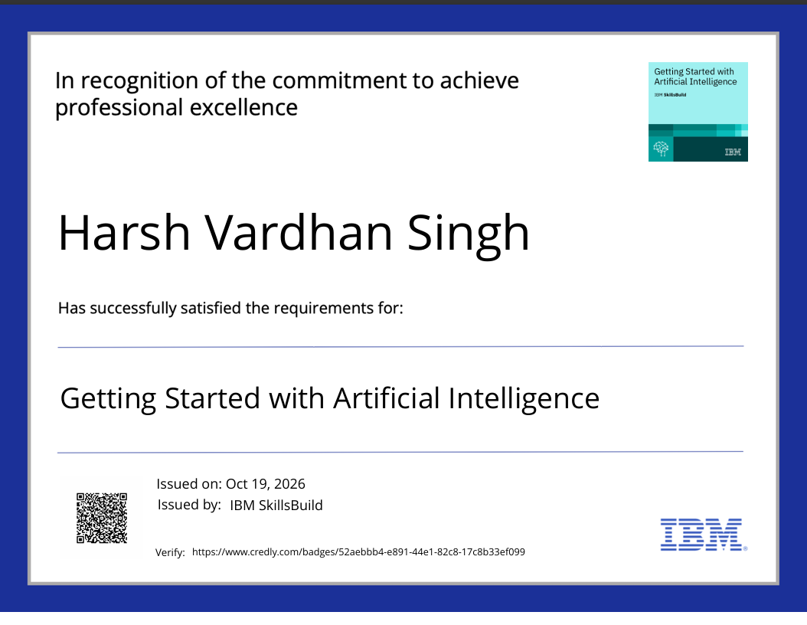
Certificates Earned:
Certificate - Getting Started with Artificial Intelligence

Slide 13
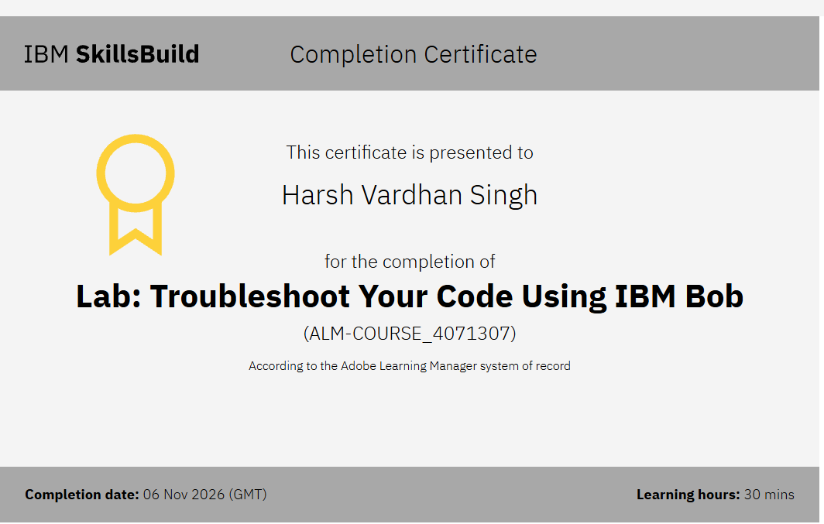
Certificates Earned:​
IBM BOB Certificate

Slide 14


